Slide 1
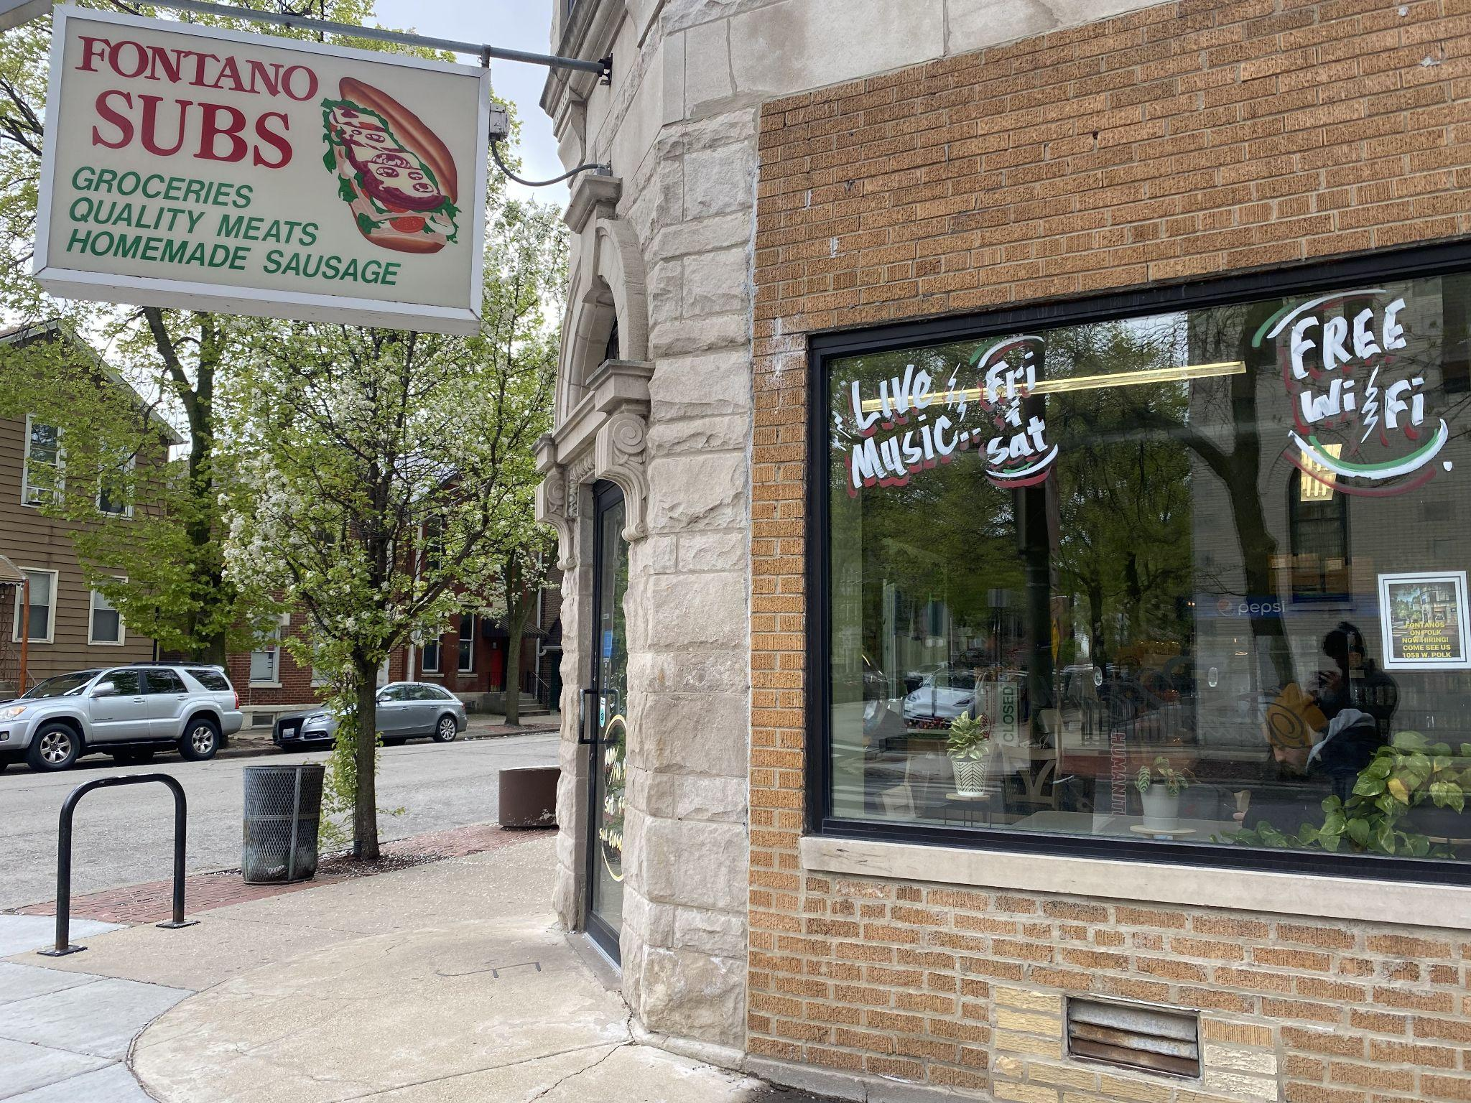
Notes:
“Fontano’s Subs in Little Italy. It is really tasty actually I highly recommend you get some. This one has prosciutto and cured provolone. My question though is how is this sandwich able to exist by keeping its prices low and competitive??? This provolone is imported from Italy, meaning that I have to pay for this provolone in Euros . How is it possible for these small businesses to function especially in mass times of uncertainty?

Slide 2
Forex Prediction Analysis
Prediction of the EUR/USD currency exchange rate by
David Serrano, George Vojvodic, Nikita Mashchenko, Yuqing Wu
Notes:
Ladies and gentlemen, Students Professor and Guests, today we’re going to examine a way for small businesses like Fontano’s Subs to purchase its goods overseas at a low price.

Slide 3
Problem
Many small to medium size businesses in the US need to import products and services from abroad.
Ethnic food stores
Manufacturers
Resellers
Etc …

Slide 4
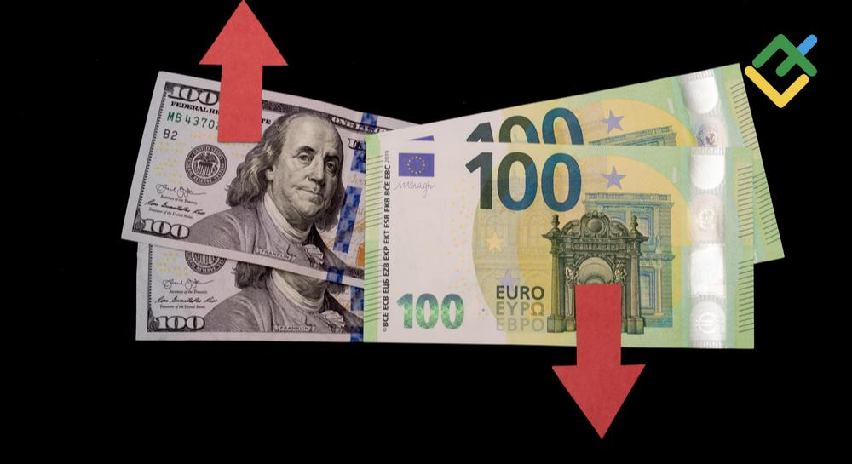
Problem
Businesses rely on stable currency exchange rates in order to conduct business.
Unfortunately, exchange rates can fluctuate a lot throughout any given year.
Wars
Pandemic
Change in economic conditions
Government interventions
Banks’ appetite for risk

Slide 5

Problem
Businesses want to know if they should pay for imported products / services sooner or later.
Dollar appreciates later
Pay later
Dollar depreciates later
Pay now
Allows businesses to save money on purchases.

Slide 6
Approach
Predict the future exchange rate movement (up or down) of the Euro / Dollar pair (EURUSD) by using:
Technical Indicators
Macroeconomic data
See if economic fundamentals play a major role in exchange rate movement.
Goal
Notes:
This is the equation for determining the value of an exchange rate. But when tested and put into practice, the formula does not work. In order to make up for the descripincys, the financial literature says that there is white noise.

Slide 7
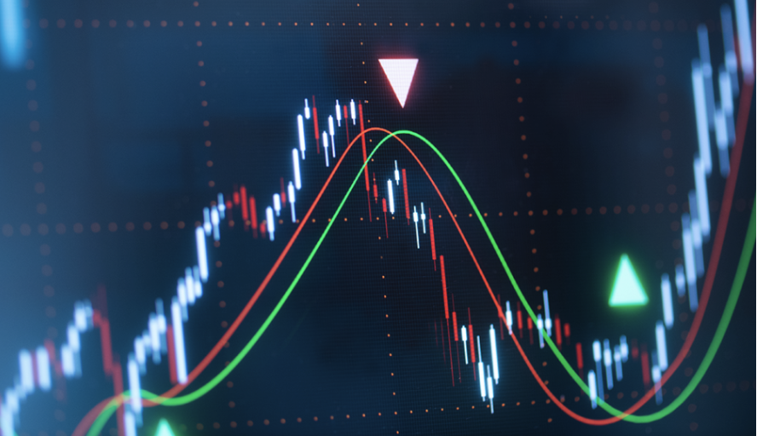
Approach
Technical Indicators
Moving Averages
RSI (Relative Strength Index)
Finds potentially overbought / oversold areas.
MACD (Moving Avg. Convergence / Divergence)
Bollinger Bands
Previous days’ close rates.
Macroeconomic Indicators
Interest rates in the US and Euro Zone
Inflation Rates
Dollar Index (DXY)
Main Features
Notes:
This is the equation for determining the value of an exchange rate. But when tested and put into practice, the formula does not work. In order to make up for the descripincys, the financial literature says that there is white noise.

Slide 8
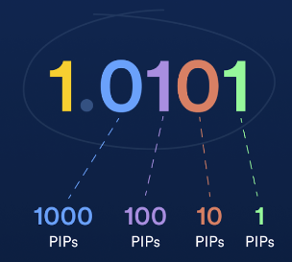
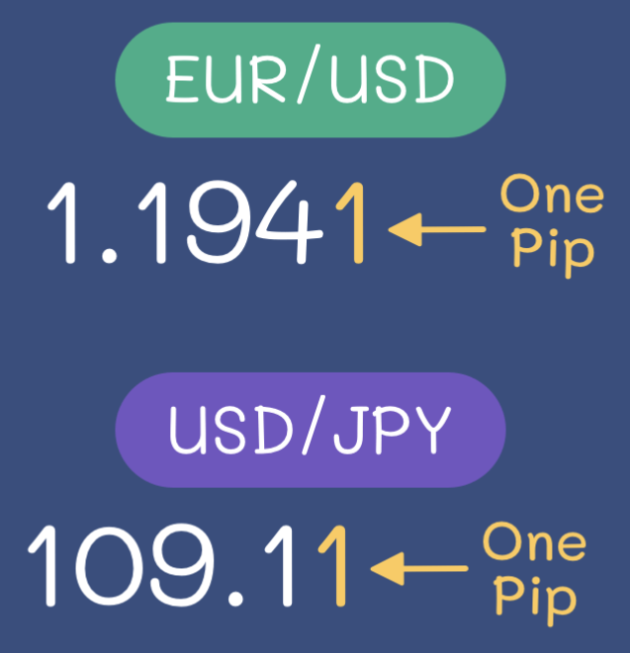
Approach
The smallest fractional unit of any given currency is called a pip.
Higher interest rates make a given currency more appealing, and vice versa.
Interest rate differential between two currency zones moves the exchange rate.
Increase in inflation tends to be followed by an increased interest rates, due to governments trying to curb it, and vice versa.
Little Background
Notes:
This is the equation for determining the value of an exchange rate. But when tested and put into practice, the formula does not work. In order to make up for the descripincys, the financial literature says that there is white noise.

Slide 9

The Data Mining.

Slide 10


Approach
Yahoo Finance
For EUR/USD rates, DXY, and US treasury yield rates.
ECB (European Central Bank)
For Euro treasury yield rates.
www.usinflationcalculator.com
For historical US inflation data.
www.rateinflation.com
For historical Euro area inflation data.
Data Collection
Notes:
This is the equation for determining the value of an exchange rate. But when tested and put into practice, the formula does not work. In order to make up for the descripincys, the financial literature says that there is white noise.

Slide 11
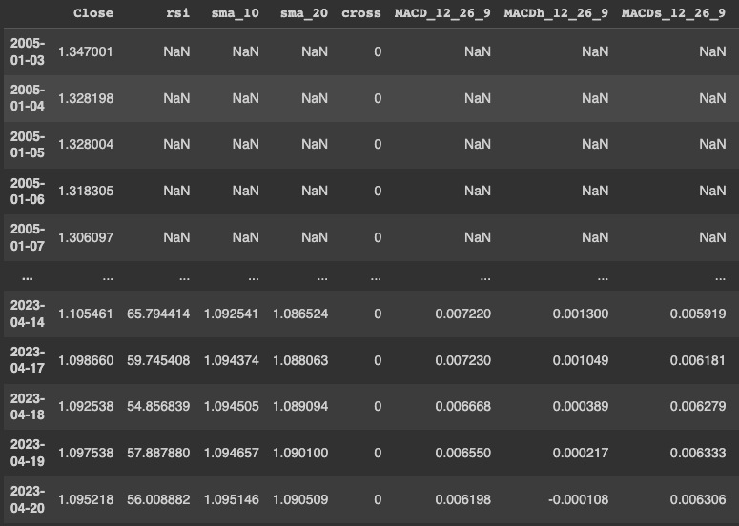
Approach
Used Google Colab for data preparation.
Data imported via API, online CSV and HTML tables.
Formatted into a date index and value columns.
Combined into one single dataframe.
Null values handled by trimming top and bottom rows, as well as forward filling.
Added labels for next day's price movement (up/down) and 7 days later (coded as 1 or 0)
Data Preparation
Notes:
This is the equation for determining the value of an exchange rate. But when tested and put into practice, the formula does not work. In order to make up for the descripincys, the financial literature says that there is white noise.

Slide 12
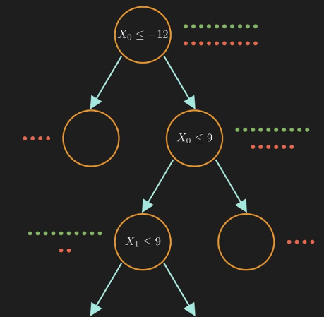
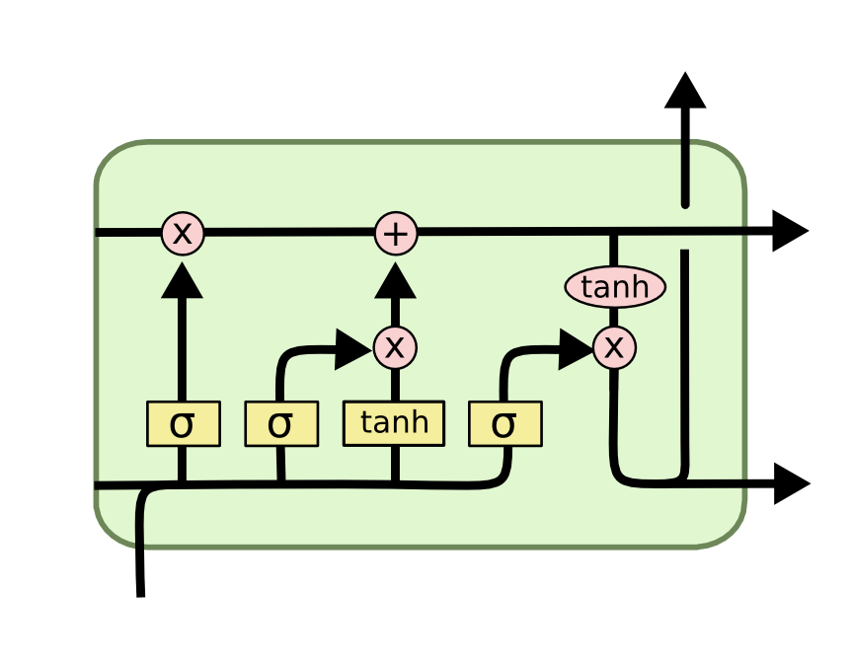
Approach
Two main models used in forecasting future price movements for many financial instruments:
Random Forests
LSTM (long short-term memory) networks
Model Selection
Notes:
This is the equation for determining the value of an exchange rate. But when tested and put into practice, the formula does not work. In order to make up for the descripincys, the financial literature says that there is white noise.

Slide 13

Approach
Type of Recurrent Neural Network (RNN)
Used for sequential data modeling
Time dependent, like stocks
Sequential text generation
The model does not provide a significant increase in accuracy for financial data over random forests.
LSTM
Long short-term memory
Notes:
This is the equation for determining the value of an exchange rate. But when tested and put into practice, the formula does not work. In order to make up for the descripincys, the financial literature says that there is white noise.

Slide 14
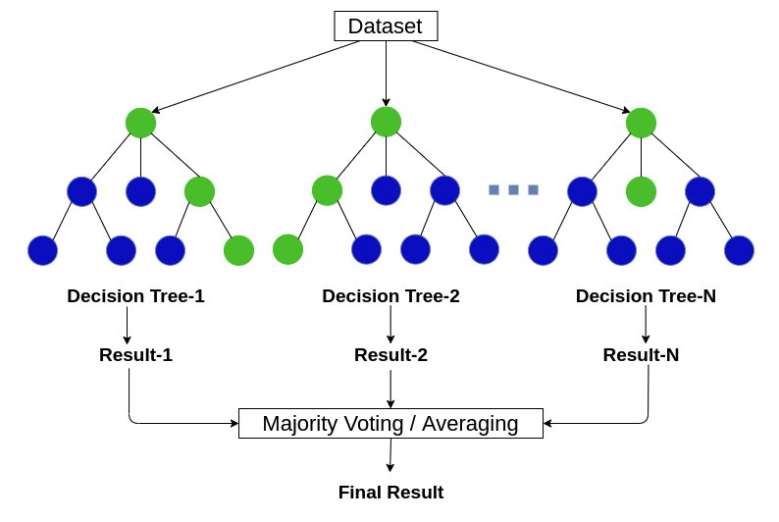
Approach
Our Approach
Ensemble method combining multiple decision trees.
Model generates different tree iterations.
Majority vote taken at the end to make the final prediction.
Random Forest Classifier
Notes:
This is the equation for determining the value of an exchange rate. But when tested and put into practice, the formula does not work. In order to make up for the descripincys, the financial literature says that there is white noise.

Slide 15
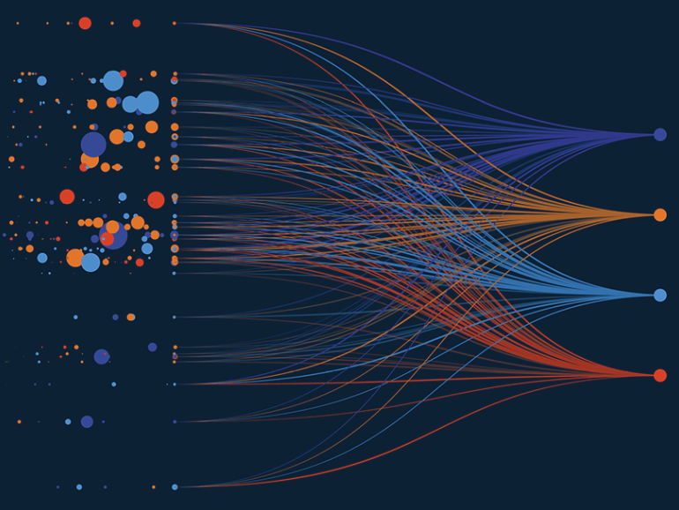
Evaluation
Classification on two separate labels.
Next day closed above or below.
The close 7 days ahead was above or below.
Tuned two different hyperparameters.
Max tree depth (5 to 50 in increments of 5)
Number of estimators (trees) to use
5 to 60 in increments of 5
Around 4500 rows of training data.
Aug 2005 to April 2023.
Training & test data was split 80 / 20
Notes:
This is the equation for determining the value of an exchange rate. But when tested and put into practice, the formula does not work. In order to make up for the descripincys, the financial literature says that there is white noise.

Slide 16
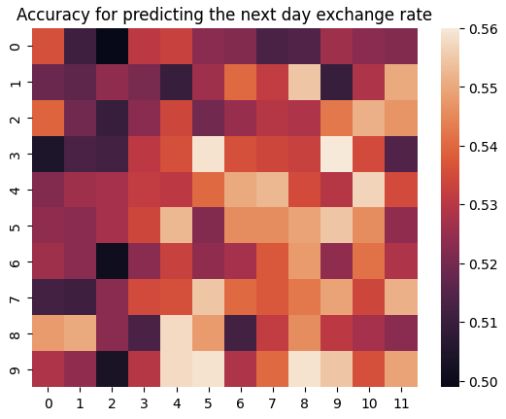
Result
There was an accuracy of 50-56%
Classifier was only slightly better on average as the max depth and # of trees increased.
In line with our prediction as there is a lot of daily market noise.
We expected an average of 50-53%
Very hard to predict whether the exchange rate will go up or down the next day.
Next Day’s Movement Prediction
Max depth ->
Number of trees ->
Notes:
This is the equation for determining the value of an exchange rate. But when tested and put into practice, the formula does not work. In order to make up for the descripincys, the financial literature says that there is white noise.

Slide 17
However . . . . .
When predicting if the exchange rate closed higher or lower 7 days later . . .

Slide 18
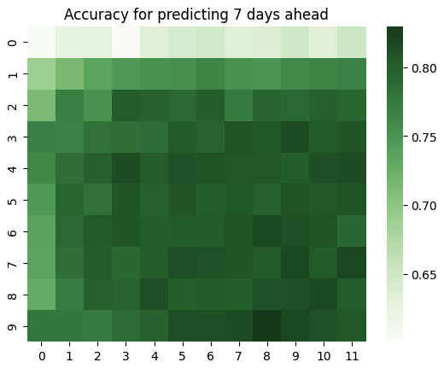


Result
We see an accuracy of up to 80% given a higher max depth and more tree enumerations. How?
Max depth ->
Number of trees ->
Notes:
This is the equation for determining the value of an exchange rate. But when tested and put into practice, the formula does not work. In order to make up for the descripincys, the financial literature says that there is white noise.

Slide 19
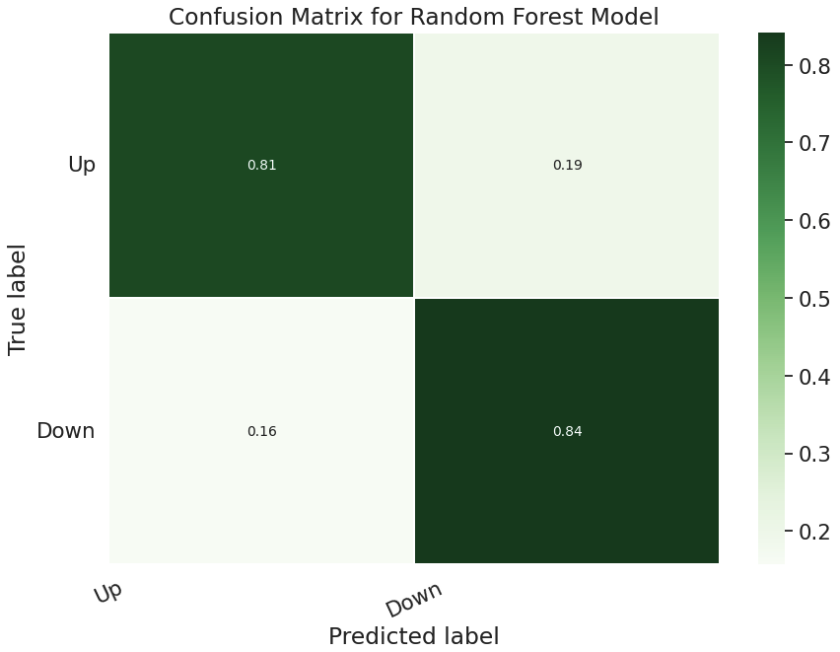
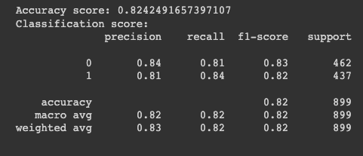
Confusion Matrix and Classification Score

Slide 20
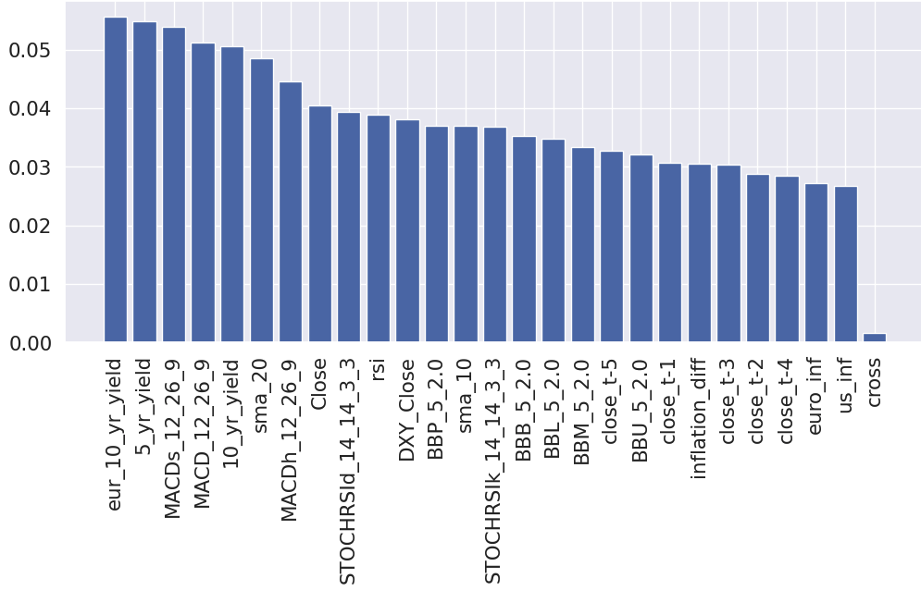
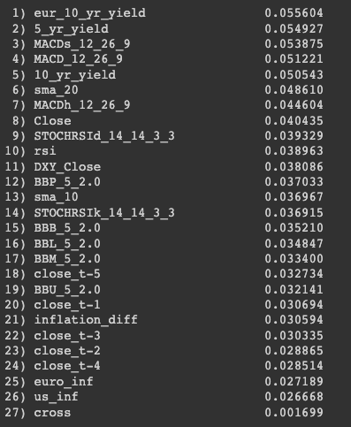
What features were mostly responsible?

Slide 21
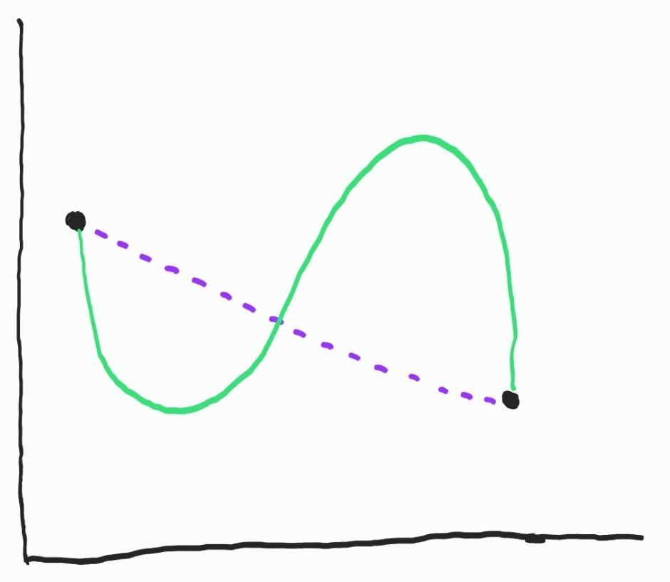
Problems
Model did not go through cross validation, the performance may change.
Inflation rates are released about once per month, so there was no variation within each month, only between months, making it a suboptimal feature.
Price movement prediction did not take into account what the price does between the current day and 7 days ahead.
Price movement may also have been negligible, anywhere between 5-50 pips, which is not a strong indication of an actual movement.
Notes:
This is the equation for determining the value of an exchange rate. But when tested and put into practice, the formula does not work. In order to make up for the descripincys, the financial literature says that there is white noise.

Slide 22

Next Steps
Try more macroeconomic indicators.
Remove any that seem to be unimportant.
Implement cross validation.
Compare this model to an LSTM model.
Evaluate another pair of currencies.
Predict movement 5, 10, 14 days in advance.
Notes:
This is the equation for determining the value of an exchange rate. But when tested and put into practice, the formula does not work. In order to make up for the descripincys, the financial literature says that there is white noise.

Slide 23
We thank you for listening. Please feel free to ask
any questions.

